Slide 1
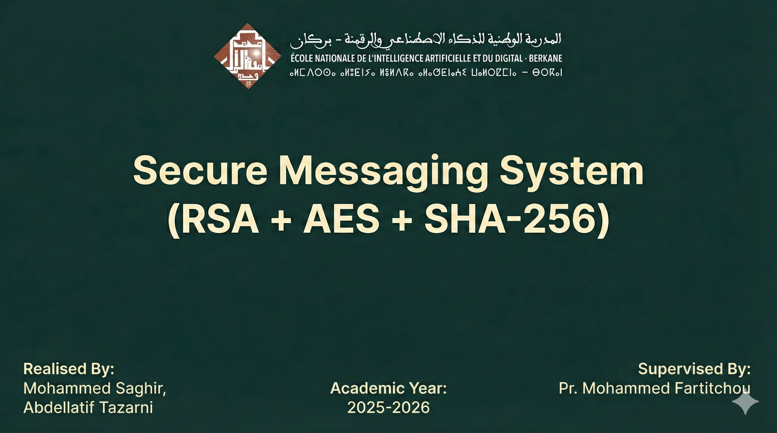

Slide 2
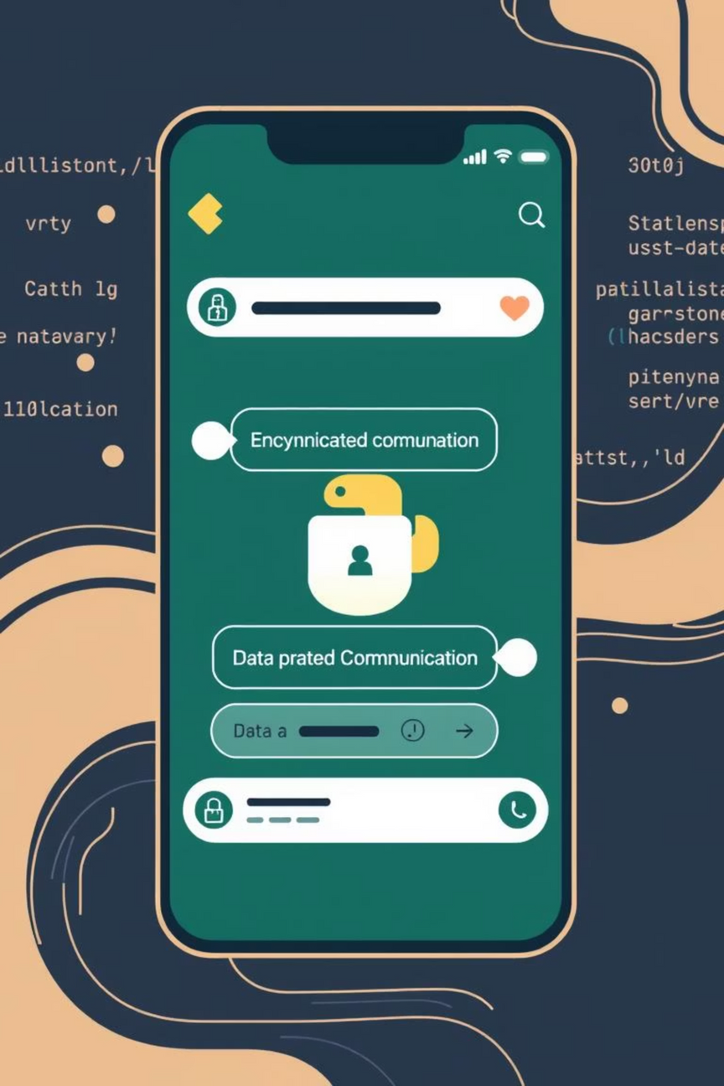

Building a Secure Python Chat App
This presentation outlines the architecture and key cryptographic principles behind building a secure peer-to-peer Python GUI chat application. We'll explore how modern encryption and authentication methods ensure privacy and integrity in direct messaging.
Notes:
1

Slide 3
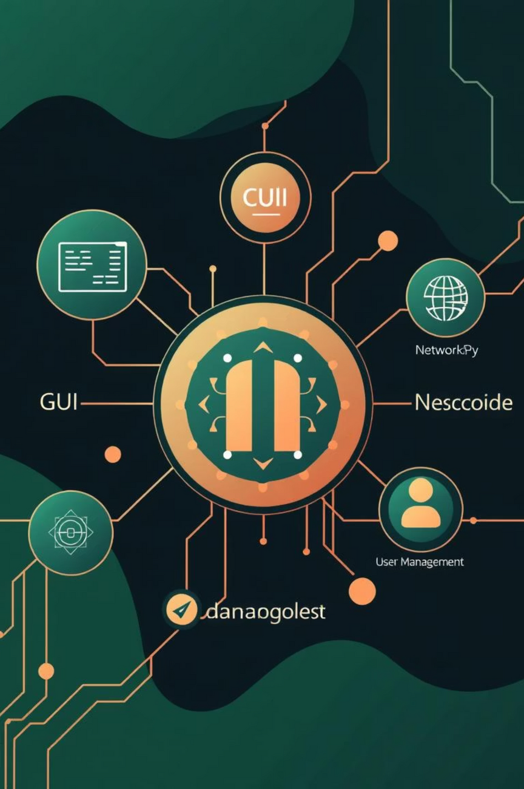
Project Overview
Core Components
User Interface (Tkinter)
A familiar and intuitive graphical interface for seamless user interaction and message display.
Network Module (Sockets)
Handles peer-to-peer connections, message transmission, and reception for robust communication.
Cryptography (Hazmat)
Implements RSA for key exchange and AES for secure message encryption, ensuring data confidentiality.
User Management
Manages user identities and cryptographic keys for secure and personalized communication.
Notes:
2

Slide 4


Application Flow: Connect or Host
Host Mode
Client Mode
Initiates a server socket, listening for incoming connections.
Attempts to connect to a specified IP address and port.
Binds to a specified IP address and port.
Once connected, initiates the client-side handshake.
Awaits a client connection to establish communication.
Exchanges keys with the host to establish a secure channel.
Performs handshake as the server, exchanging keys.
Ready for secure messaging with the host.
The application provides distinct modes for establishing a peer-to-peer connection, facilitating either hosting a chat session or connecting to an existing one.
Notes:
3

Slide 5
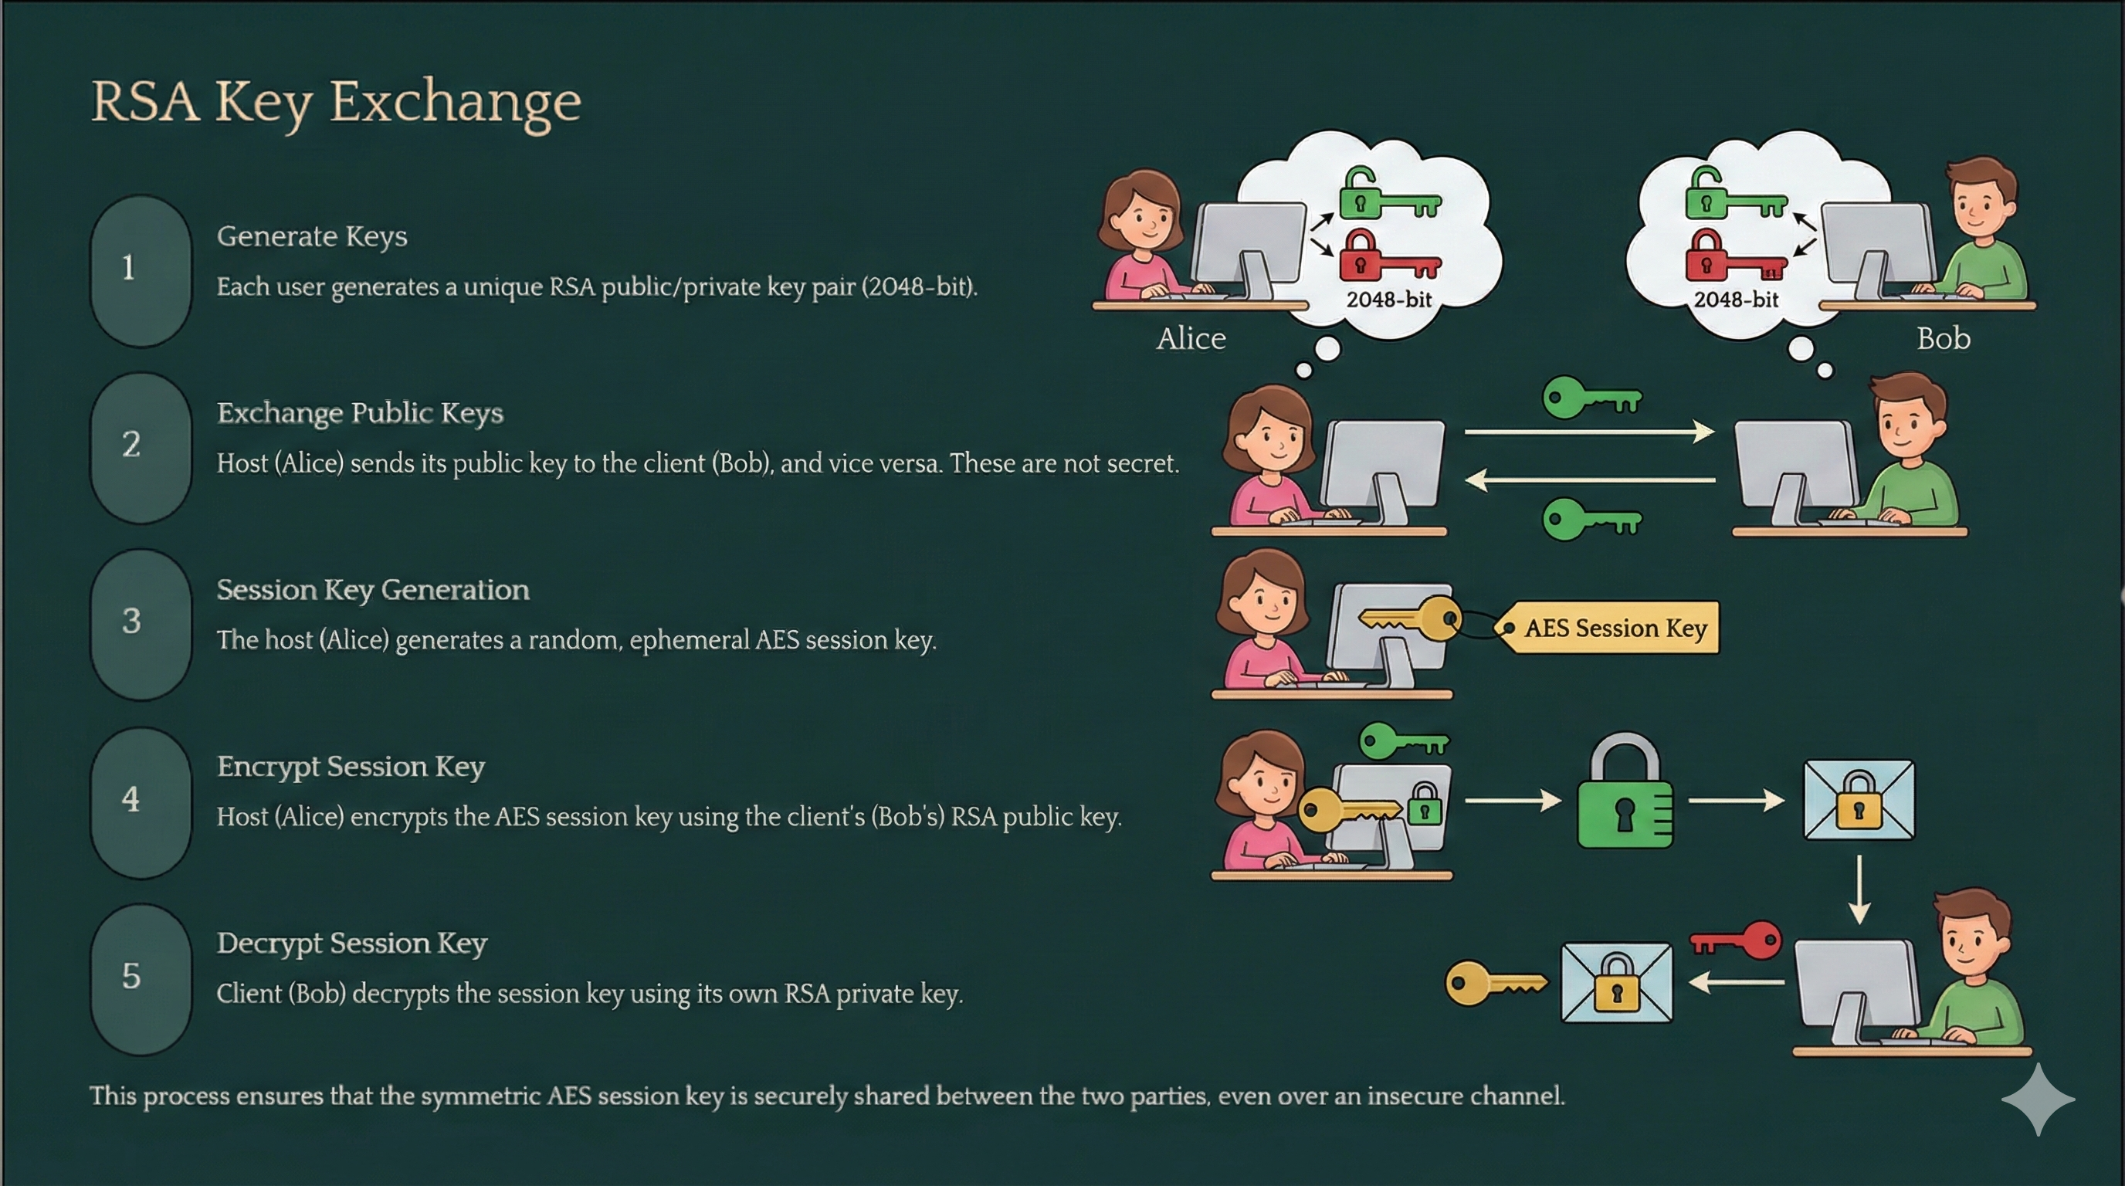

Slide 6
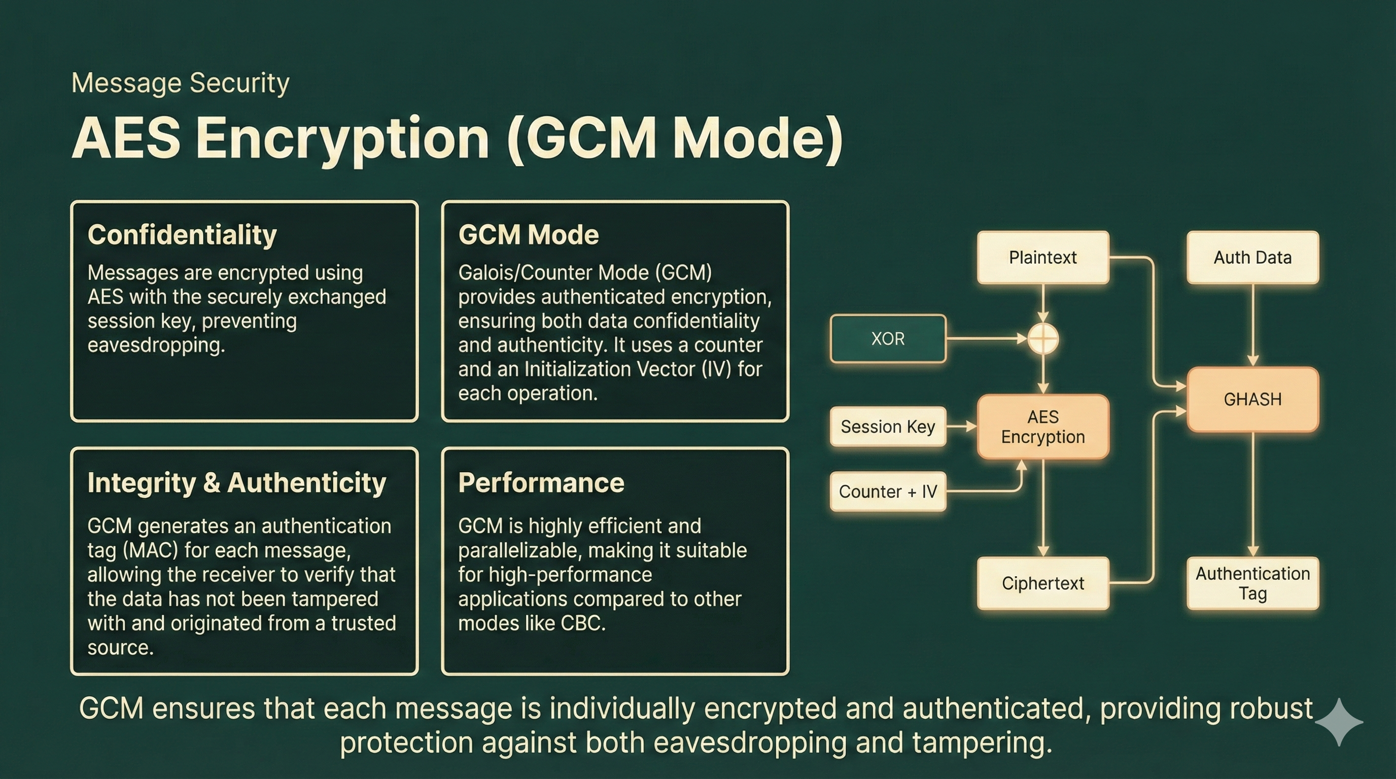

Slide 7
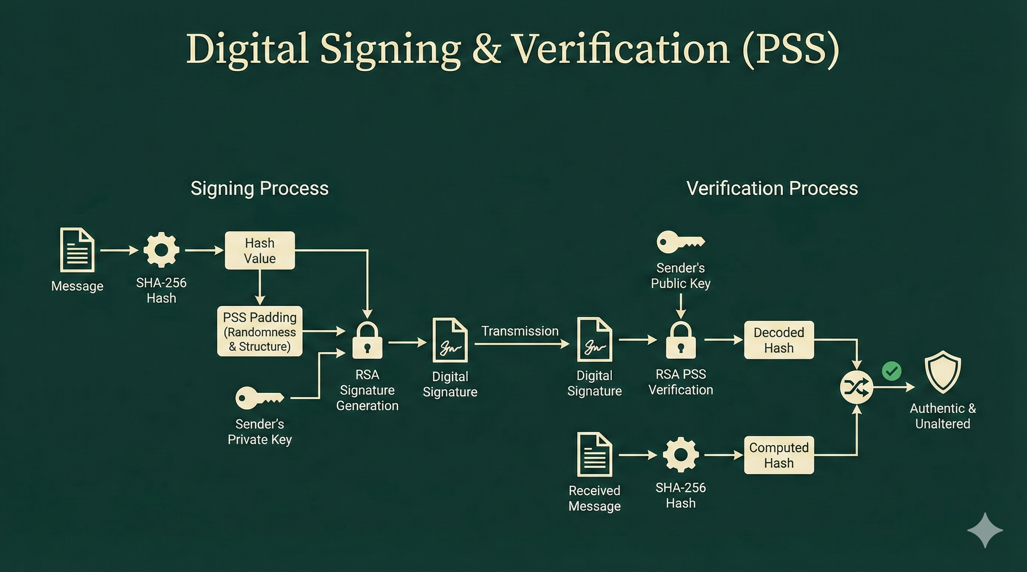

Slide 8
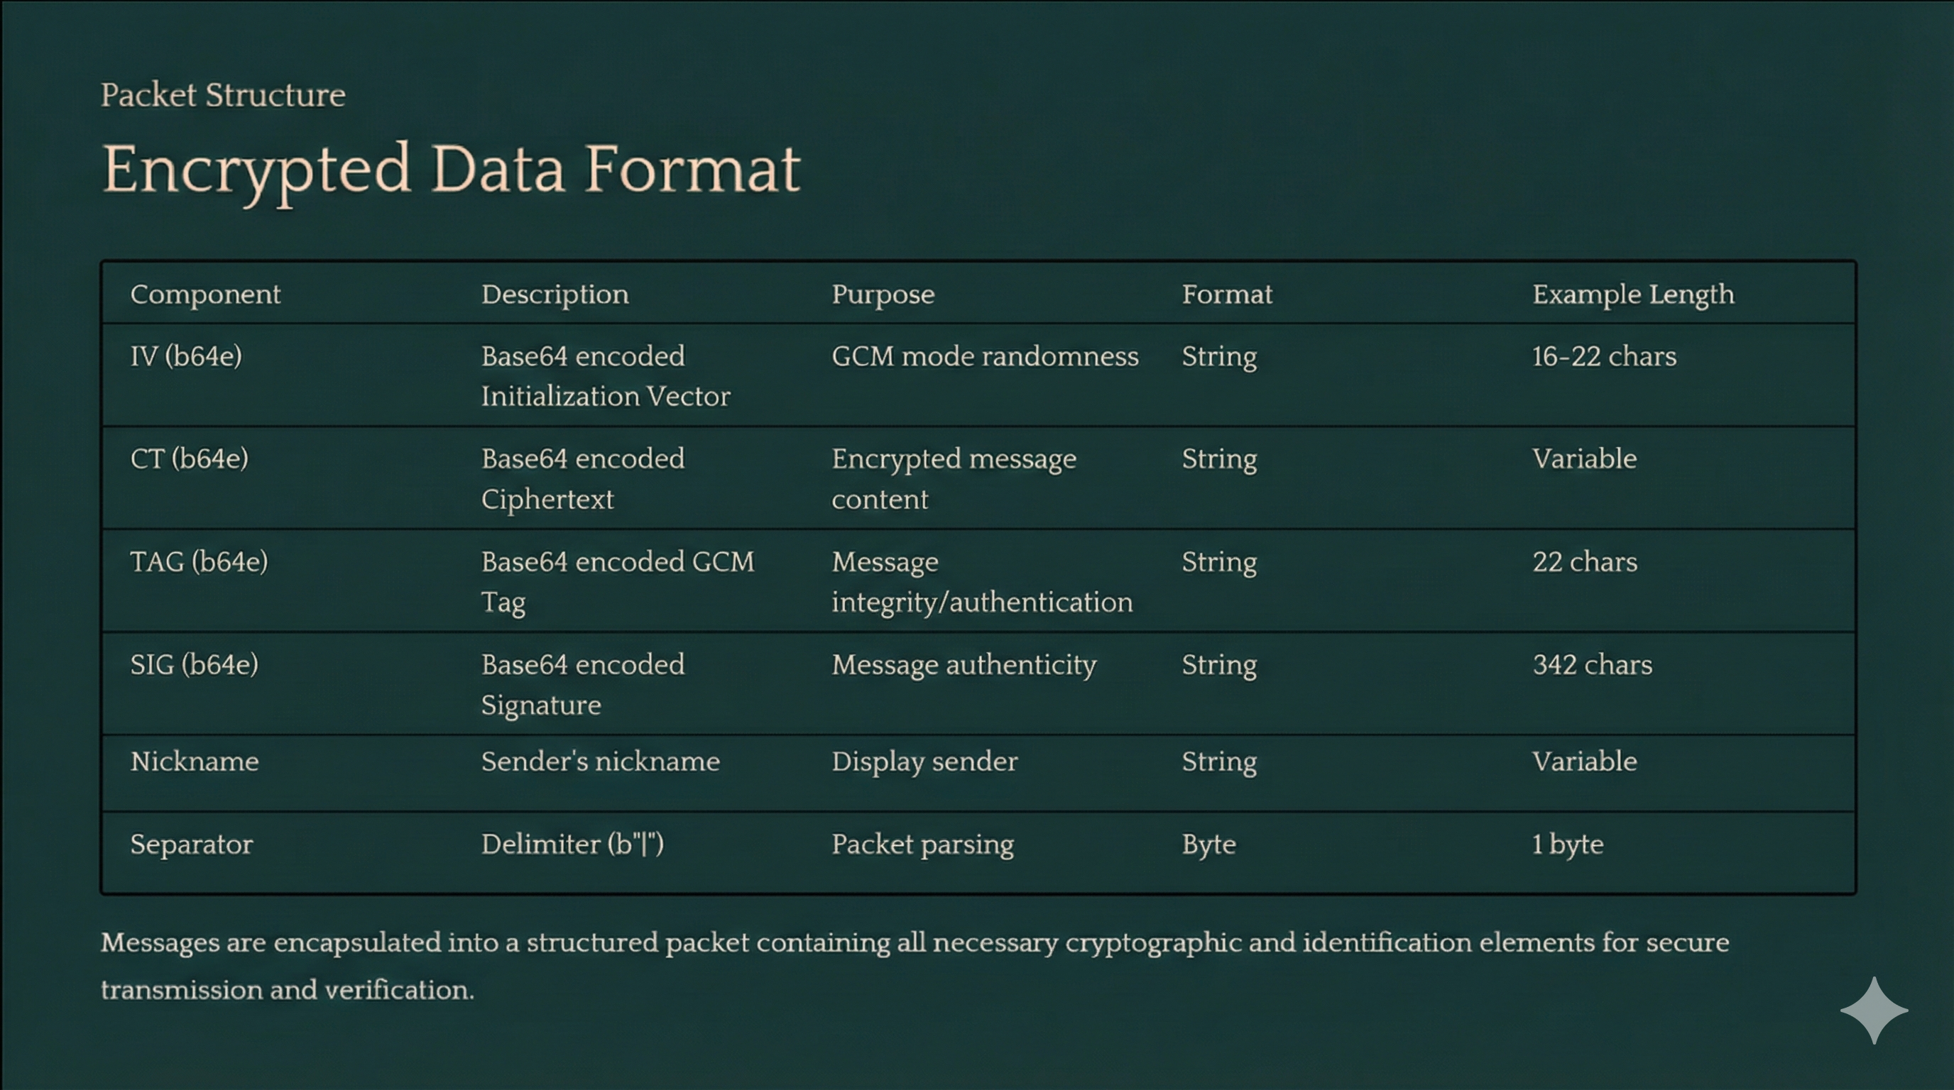

Slide 9
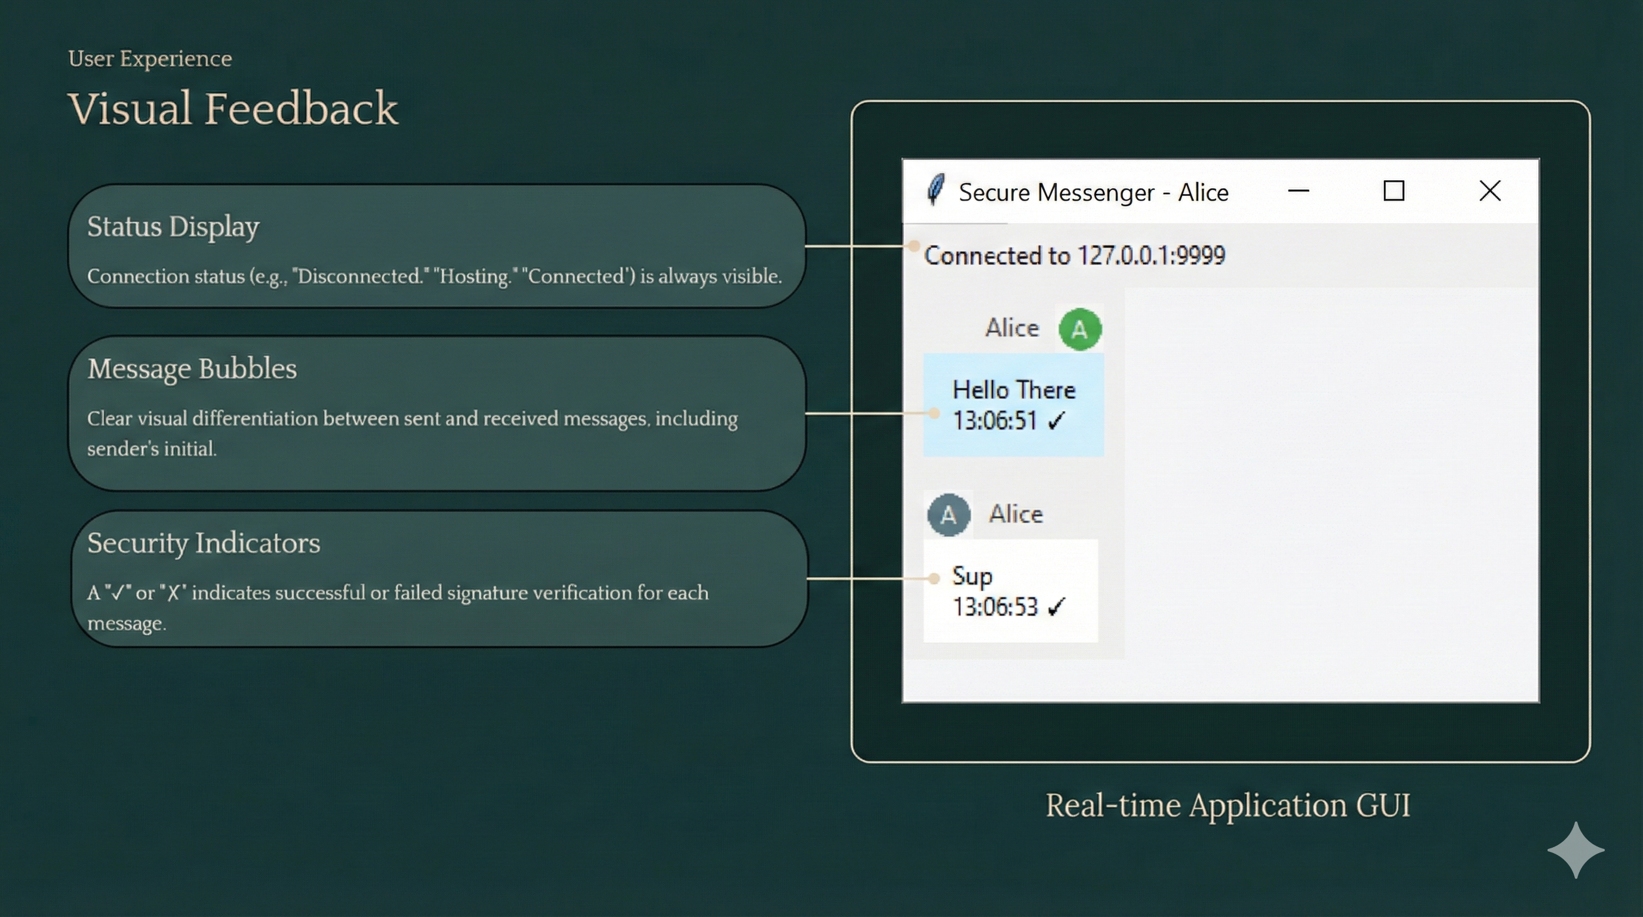

Slide 10
Demonstration

Slide 11




Summary: A Robust Foundation
1
End-to-End Encryption
2
Authenticated Messaging
3
Peer-to-Peer Communication
4
Python & Tkinter
This project demonstrates a practical application of advanced cryptographic techniques to build a secure, private, and trustworthy communication platform using Python.
Notes:
10

Slide 12


